Slide 1

Learning Objective
I will use the “make easy numbers” strategy and identify the commutative and associative laws
Enter quietly, please be ready with the following on your desk:
Whiteboard
Whiteboard marker
File Paper
Pencil, ruler and red pen
Scissors and glue stick
Calculator
Diary
Device – charged or borrowed from Library before maths

Slide 2

Daily Review
No daily review.

Slide 3

Learning Objective
CFU
What will we learn today?
I will use the “make easy numbers” strategy and identify the commutative and associative laws
CFU
How will you know that you are successful?
Success Criteria
At the end of the lesson, I will be able to:
Calculate using the “make easy numbers’ strategy
Identify the commutative law
Identify the associative law

Slide 4
Activate prior knowledge
Whiteboards
Add 5 and 6
2 + 6 =
5 + 6 = 11
5 + 7 =
4 + 10 =
Add 7 and 9
1 + 1 =
7 + 9 =
7 + 9 = 16
23 + 16 =

Slide 5
Activate prior knowledge
Whiteboards
Multiply 5 and 6
2 x 6 =
5 x 6 = 30
5 x 8 =
2 x 11 =
Multiply 7 and 9
12 x 1 =
3 x 7 =
7 x 9 = 63
20 x 6 =

Slide 6
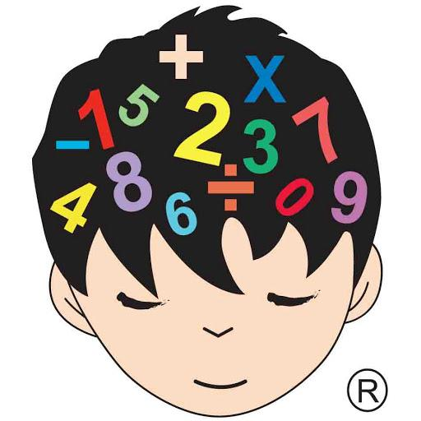
Relevance
You will need to develop easy strategies to help you add and multiply without a calculator
That scooter looks awesome – I have $230 and the scooter is $192, but I need enough money for my bus fare…
Luckily, I can use my
mental strategies to help!!

Slide 7
Concept development
CFU 1
What is the Commutative law?
Commutative law – the order in which I add or multiply any two numbers does not change the answer
5 x 7 = 35
7 x 5 = 35
7 + 8 = 15
8 + 7 = 15

Slide 8
Skill Development
CFU 1
What do we know about 4+7 and 7+4?
The order in which you add or multiply two numbers, does not change the results
CFU 2
What do we know about 3+8 and 8+3?
4 + 7 = 11
CFU 3
What is this law called?
7 + 4 = 11
This is called the commutative law

Slide 9
Skill Development
CFU 1
What do we know about 14+7 and 7+14?
The order in which you add or multiply two numbers, does not change the results
CFU 2
What do we know about 13+8 and 8+13?
10 + 7 = 17
CFU 3
What is this law called?
7 + 10 = 17
This is called the commutative law

Slide 10
Skill Development
CFU 1
What do we know about 4x7 and 7x4?
The order in which you add or multiply two numbers, does not change the results
CFU 2
What do we know about 3x8 and 8x3?
4 x 7 = 28
CFU 3
What is this law called?
7 x 4 = 28
CFU 4
What does this law state?
This is called the commutative law

Slide 11
Skill Development
CFU 1
What do we know about 4x10 and 10x4?
The order in which you add or multiply two numbers, does not change the results
CFU 2
What do we know about 10x8 and 8x10?
10 x 7 = 70
CFU 3
What is this law called?
7 x 10 = 70
CFU 4
What does this law state?
This is called the commutative law

Slide 12
Concept Development
CFU 1
What is the Associative law?
Associative law – the order in which 3 or more numbers are added or multiplied, does not change the results
CFU 2
What does the associative law state?
2 x 3 x 5 = 30
3 x 5 x 2 =30
6 + 7 + 8 = 21
7 + 8 + 6 = 21

Slide 13
Skill Development
CFU 1
What do we know about 4 x 10 x 2 and 10 x 2 x 4?
The order in which three or more numbers are added or multiplied, does not change the results
CFU 2
What do we know about (10x2)x4 and 10x(2x4)?
3 x 7 x 2 = 42
CFU 3
What is this law called?
7 x 2 x 3 = 42
CFU 4
What does this law state?
This is called the associative law

Slide 14
Skill Development
CFU 1
What do we know about 4 x 5 x 2 and
5 x 4 x 2?
The order in which three or more numbers are added or multiplied, does not change the results
CFU 2
What do we know about 3x2x4 and 2x4x3?
5 x 2 x 3 = 30
CFU 3
What is this law called?
2 x 3 x 5 = 30
CFU 4
What does this law state?
This is called the associative law

Slide 15
Question
There may be more than one!!
Which of the following are examples of the commutative law?
A: 3 + 4 = 4 + 3
B: 10 + 6 = 5 + 5 + 3 + 3
C: 5 x 6 = 6 x 5
D: 4 + 2 + 10 = 10 + 4 + 2
E: 3 x 4 x 8 = 3 x 8 x 4
F: 3 x 4 = 10 + 2

Slide 16
Question
Which of the following are examples of the associative law?
A: 3.2 + 7.4 = 7.4 + 3.2
B: 10 + 6 = 5 + 5 + 3 + 3
C: 17 x 6 = 6 x 17
D: 4 + 2 + 10 = 10 + 4 + 2
E: 3 x 4 x 8 = 3 x 8 x 4
F: 3 x 4 x 7 = 7 x 4 x 3

Slide 17
Concept Development
We will now add using the ‘make easy numbers’ strategy
Whiteboards
7 + 32 + 13
3 + 44 + 17
= 7 + 13 + 32 (swap the 32 and the 13)
= 20 + 32
CFU 1
= 52
Why did we place the 7 and 13 together?

Slide 18
Concept Development
We will now add using the ‘make easy numbers’ strategy
Whiteboards
5 + 32 + 5
25 + 52 + 5
= 5 + 5 + 32 (swap the 32 and the 5)
= 10 + 32
CFU 1
Why did we place the 5 and 5 together?
= 42

Slide 19
Concept Development
We will now add using the ‘make easy numbers’ strategy
Whiteboards
2 x 13 x 5
2 x 22 x 5
= 2 x 5 x 13 (swap 13 and 5)
= 10 x 13
CFU 1
Why did we swap the 13 and 5?
= 130

Slide 20
Concept Development
We will now add using the ‘make easy numbers’ strategy
Whiteboards
2 x 9 x 5
4 x 7 x 5
= 2 x 5 x 9 (swap 9 and 5)
= 10 x 9
CFU 1
Why did we swap the 9 and 5?
= 90

Slide 21
Guided Practice
We will now add using the ‘make easy numbers’ strategy
Whiteboards
293 + 568
194 + 365
= 293 + 7 + 561 (take the 7 from 568)
= 300 + 561
CFU 1
Why did we subtract 7 from 568?
= 861

Slide 22
Guided Practice
We will now add using the ‘make easy numbers’ strategy
Whiteboards
423 + 96
763 + 198
= 419 + 96 + 4 (take 4 from the 423)
= 419 + 100
= 519

Slide 23
Mixed Practice
Whiteboards
2 x 18 x 5
382 + 104
4 + 23 + 16

Slide 24
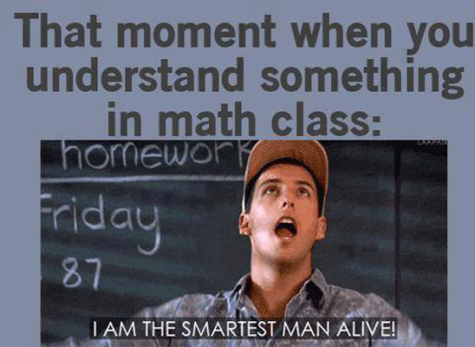
Skill Closure
What have we learnt today?
Lesson Objectives:
I will use the “make easy numbers” strategy and identify the commutative and associative laws
299 + 188
= 299 + 1 + 187 (take 1 from 188)
= 300 + 187
= 487

Slide 25


Independent Practice
Mathematics Page Layout
Open your textbooks to:
Chapter 1.1
Questions: 1

